Slide 1


Slide 2

Java OOP and Data Structures with Introduction to Secure Coding Dr. Ziping Liu
Chapter 15 LinkedList

Slide 3
https://he.kendallhunt.com/product/java-oop-and-data-structures-introduction-secure-coding
Chapter 15 LinkedList

Slide 4

Chapter Outlines
Introduction to LinkedList
Simple implementation of a singly linked list using nodes
Iterable singly linked list implementation using nodes
Doubly linked list implementation using the List interface
The built-in LinkedList collection in Java

Slide 5
15.1 Introduction to LinkedList
A LinkedList is an explicitly ordered collection of items, where each item is stored in a node.
The first item is contained in the first node, which includes a pointer to the next node in the sequence.
Each node explicitly links to the next, creating a chain-like structure.
Key Operations of a LinkedList:
Insert
Remove
LinkedLists allow efficient insertions and deletions at any point in the list. However, there is no direct access to elements—referencing an element like x[i] is not possible.

Slide 6
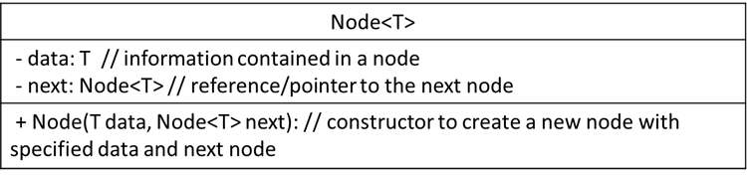
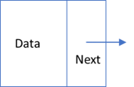
15.2 A Simple Singly Linked List Implementation Using Nodes
Definition of Node:
consists of two parts: a data field, which stores the information contained in the node, and a next field, which is a reference (or pointer) to another node. The next field allows nodes to be connected, forming a chain where one node links to another, and so on.

Slide 7
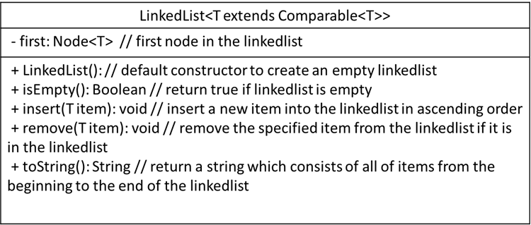
15.2 A Simple Singly Linked List Implementation Using Nodes
Definition of Singly LinkedList:
the linked structure can only be traversed in one direction—from the first node to the last.

Slide 8
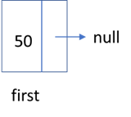
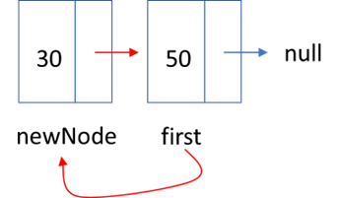
15.2.3 Implementation of Singly LinkedList
Figure 15.4 First Node is inserted
Figure 15.5 Insert at the beginning

Slide 9
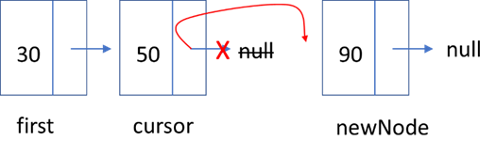
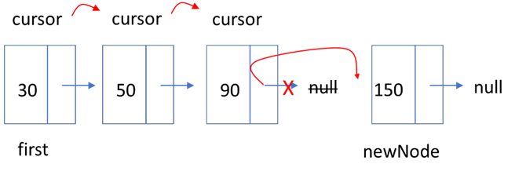
15.2.3 Implementation of Singly LinkedList
Figure 15.6 Insert at the back
Figure 15.7 Insert at the back

Slide 10
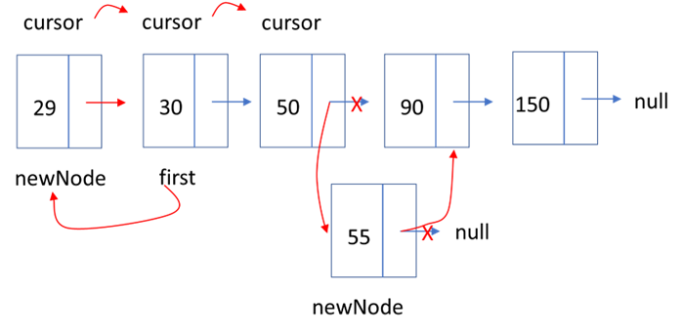
15.2.3 Implementation of Singly LinkedList
Figure 15.8 Insert in the middle

Slide 11
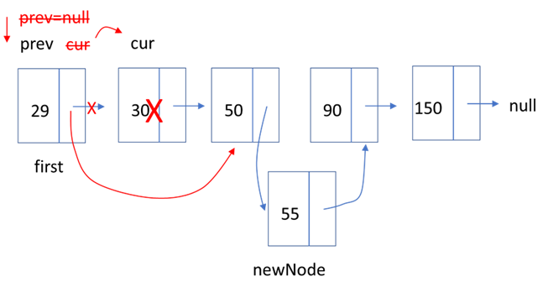
15.2.3 Implementation of Singly LinkedList
Figure 15.9 Node deleted in the middle

Slide 12
15.2 A Simple Singly Linked List Implementation Using Nodes
Core Concept: Pair-advancing in LinkedList
prev = cur; cur = cur.next;
Core Concept: loop for traversing the linked list node by node
for(Node cursor = first; cursor != null; cursor = cursor.next)

Slide 13
15.3 An Iterable Singly Linked List Implementation Using Nodes
Definition of Iterable Singly LinkedList:
the LinkedList class implements the Iterable interface, enabling both the for-each loop and iterator-based iteration.

Slide 14
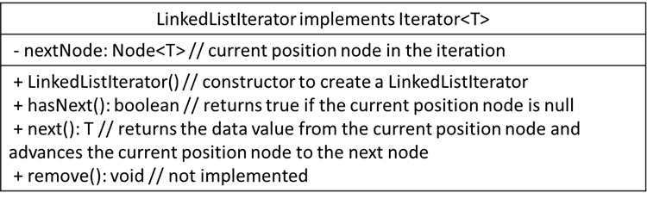
15.3 An Iterable Singly Linked List Implementation Using Nodes
Definition of LinkedListIterator:

Slide 15
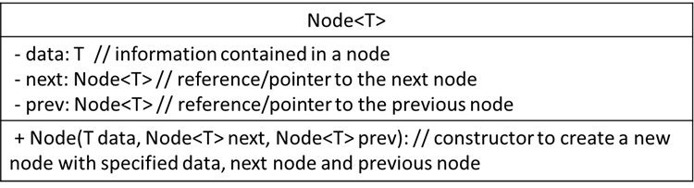
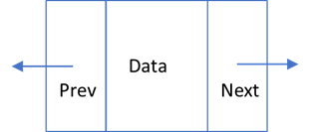
15.4 A Doubly Linked List Implementation with List Interface
Definition of Doubly Linked List:
a LinkedList is linked in both directions—forward and backward
each node contains not only a data part and a pointer to the next node (next) but also a pointer to the previous node (prev)

Slide 16
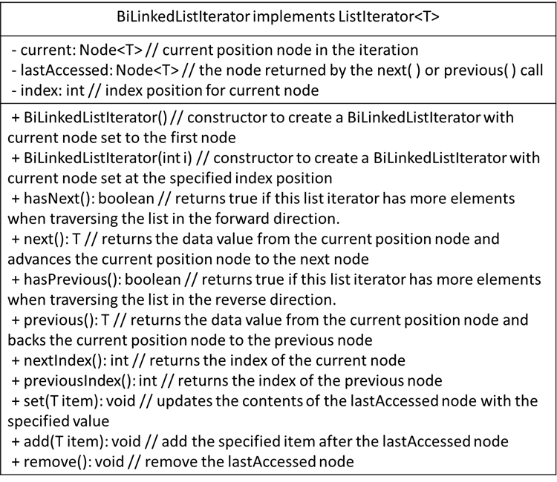
15.4 A Doubly Linked List Implementation with List Interface
Definition of BiLinkedListIterator

Slide 17
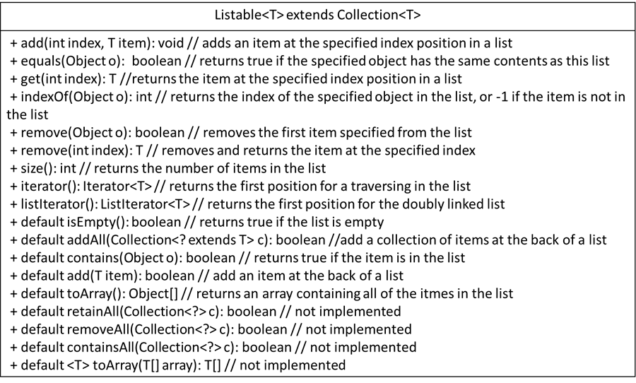
15.4 A Doubly Linked List Implementation with List Interface
Definition of Listable Interface

Slide 18
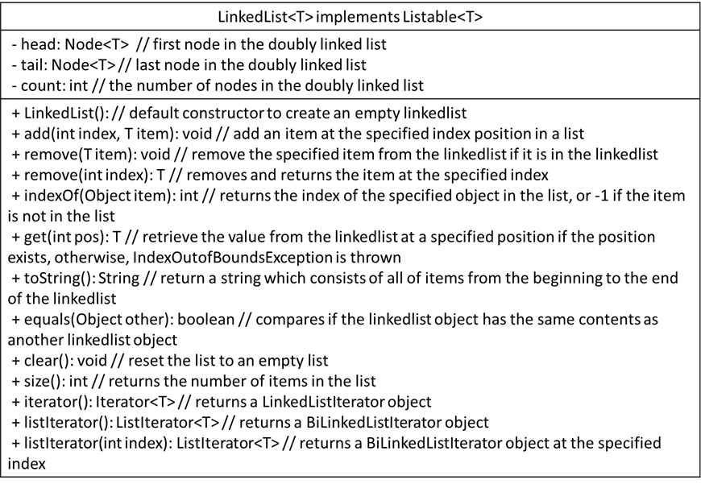
15.4 A Doubly Linked List Implementation with List Interface
Implementation of Doubly Linked List

Slide 19
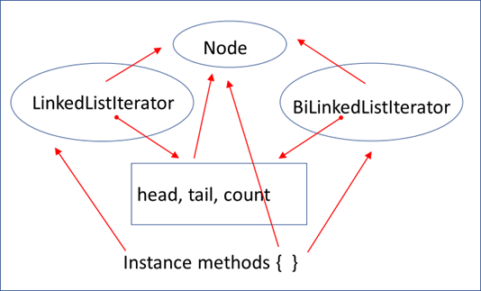
15.4 A Doubly Linked List Implementation with List Interface
Figure 5.20 Doubly linked list class components

Slide 20
15.5 Java Collections: LinkedList Usage
defined as a generic class in the package java.util.LinkedList<E>
implements both the java.util.List<E> interface and the java.util.Deque<E> interface
The List<E> interface provides methods to insert, remove, retrieve, and search items anywhere in a collection
The Deque<E> interface provides methods to insert, remove, and retrieve items at both ends of a collection
the LinkedList class can be used to create objects as a linked list ADT, a queue ADT, or a deque ADT.

